Slide 1


CAPSTONE PROJECT ON TABLEAU
SAMPLE SUPERSTORE DASHBOARD USING TABLEAU
BY – RANI DOIFODE
B.E(CSE)

Slide 2


SAMPLE SUPERSTORE DATA
DATA SOURCE:-
https://www.kaggle.com/bravehart101/sample-supermarket-dataset/version/1
https://drive.google.com/file/d/16G72fIqv4lYoaKF7EFtRXTTVEQorGBkk/view?usp=sharing

Slide 3
EXECUTION SUMMARY
This Data is Regarding the Sample Superstore Data Set.
The Data Consist Of Sales By Category, Total Sum of Profit By Category, Statewise Sales, Discount By Monthly/Years,
Sales and Profit of Subcategory, Profit By Region, Profit By Customer.
The Project Set is having 1000 Rows & 20 Columns.
This Project is made By Using Offset Function, Parameters & Conditional Formatting.
This Sample Superstore Plan Is Based on Several Years Ago and Still Useful as an Illustration Of What Superstore Plan
contains and what Issues is Covers.

Slide 4
ANALYSIS BASED ON PARAMETERS
Sales By Category.
Total Sum Profit By Category.
Statewise Sales.
What Is Average Discount By Monthly & Yearly?
Total Sum Of Sales & Profit Of Sub-Category.
What Is the Profit By Region?
Profit By Customer.

Slide 5
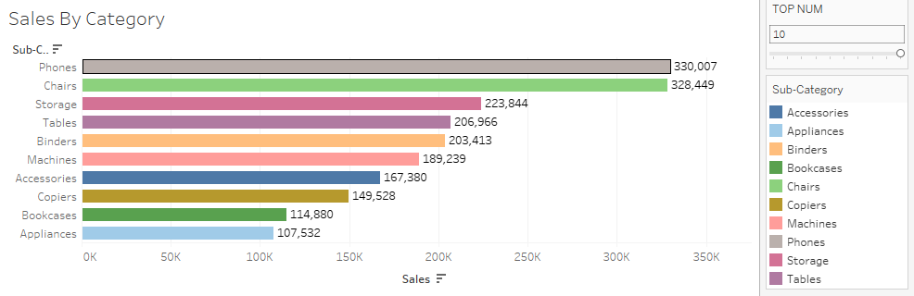
These are the sales based on the sub category part.

Slide 6
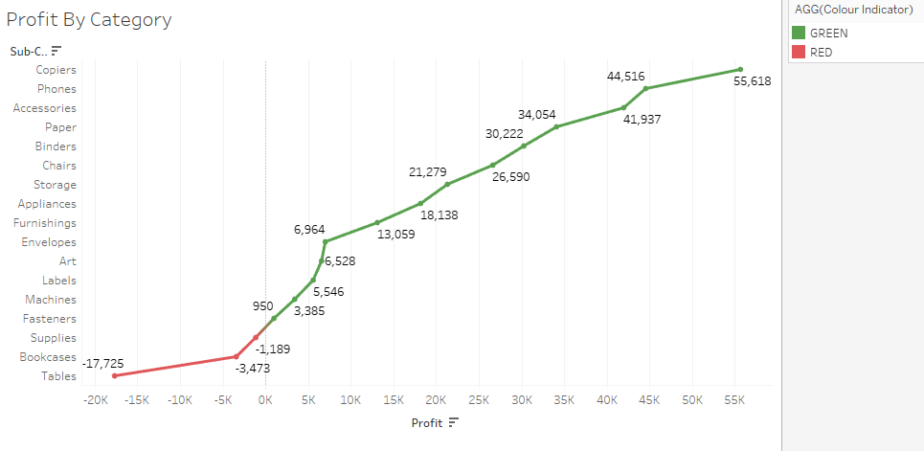
Here should presents the sum of profit by category.

Slide 7
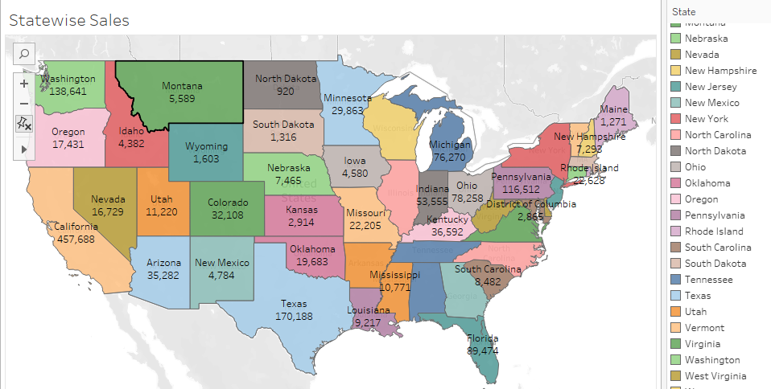
Here these chart consist of state wise sales by using geographical map chart

Slide 8
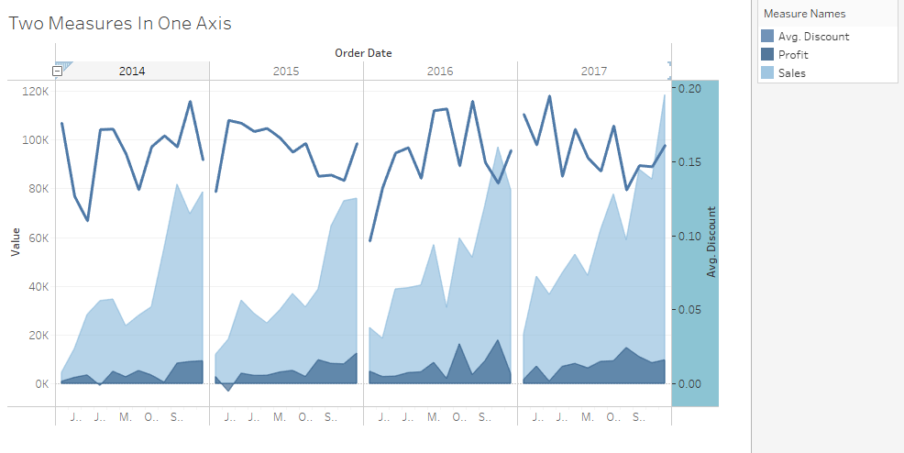
A dual axis chart with the multiple measures on one axis

Slide 9
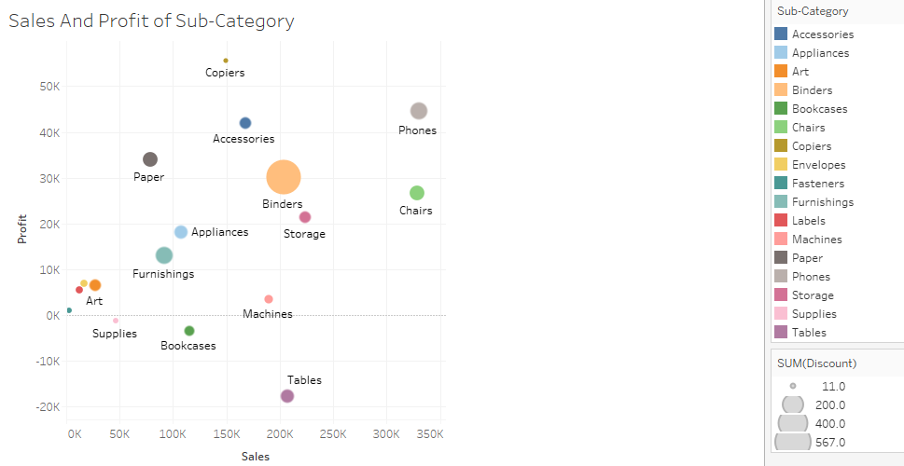
These chart consist of sales and profit of subcatgory.

Slide 10
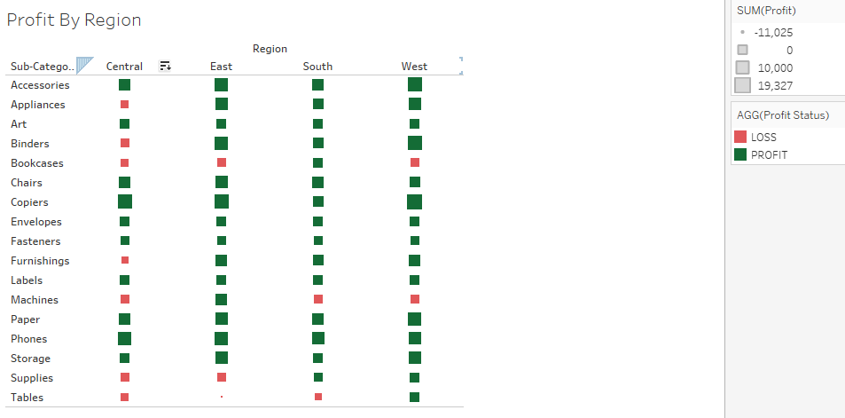
In profit by region
If the sum of profit is greater than zero then profit else loss.

Slide 11
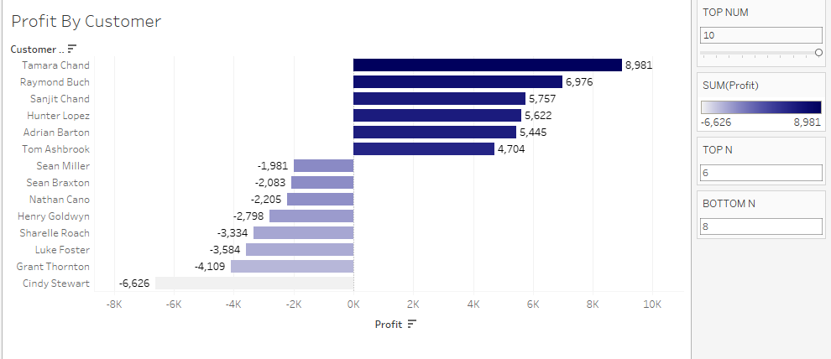
If we want to see the top 7 and bottom 7 then we can type in that if we want on it.

Slide 12
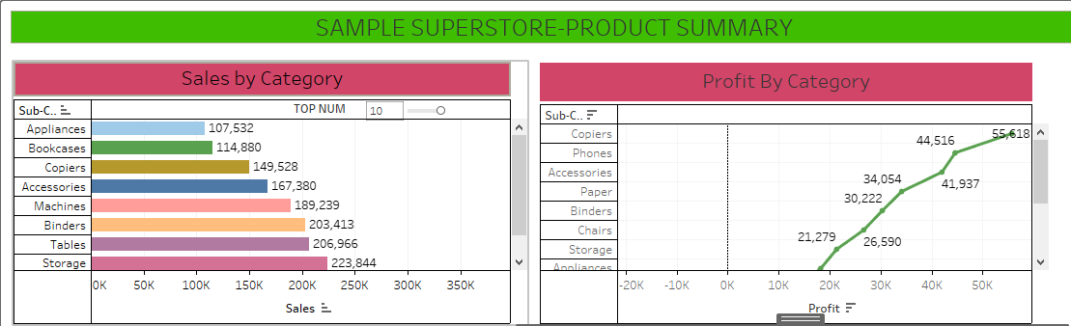
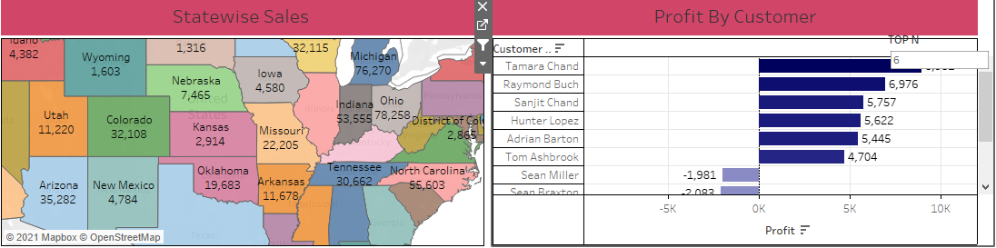

Slide 13
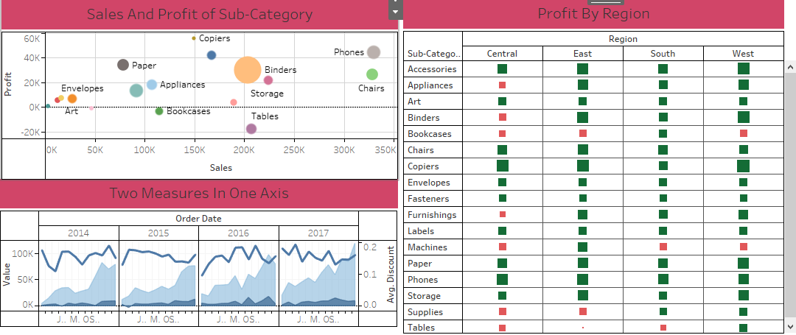

Slide 14

THANK YOU

